Slide 1
Image Detection
(RCNN families and YOLO)
Sungjoon Choi

Slide 2
R-CNN
Image
Regions
Resize
Convolution Features
Classify

Slide 3
SPP net
Image
Convolution Features
Regions
SPP
Classify

Slide 4
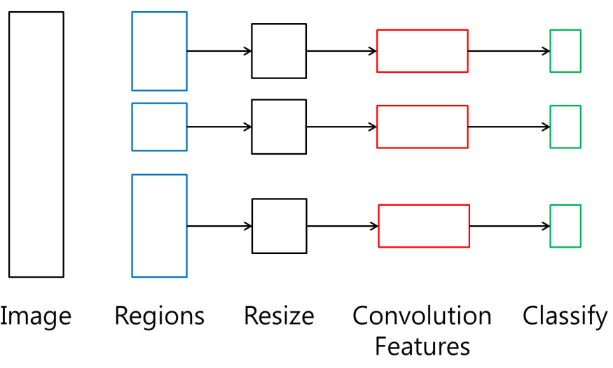
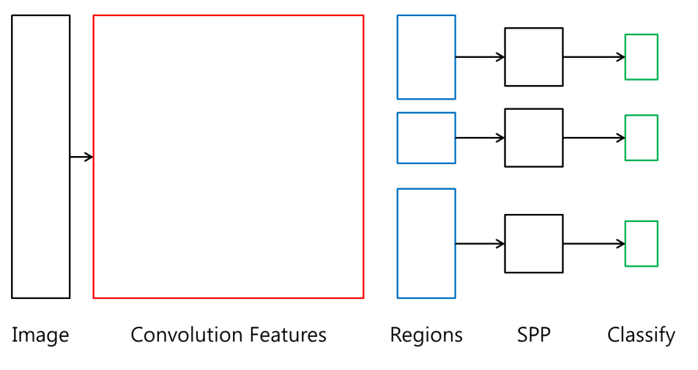
R-CNN vs. SPP net
R-CNN
SPP net

Slide 5
Fast R-CNN
Class Label
Convolution Features
RoI Pooling Layer
Confidence
Image
Class Label
Regions
RoI Pooling Layer
Confidence

Slide 6
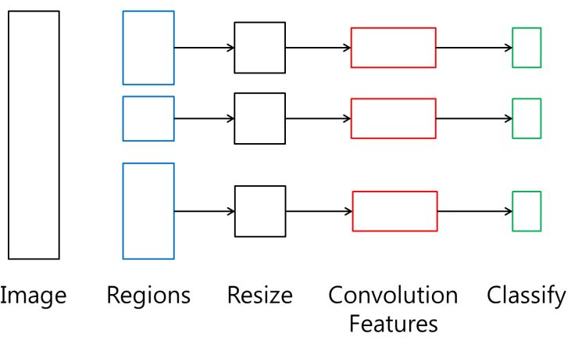

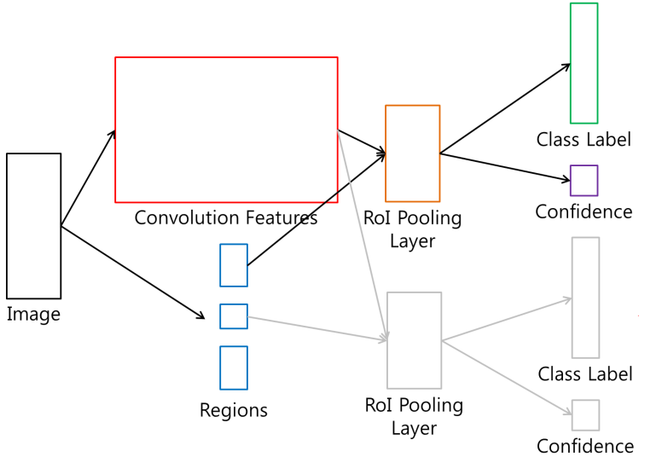
R-CNN vs. SPP net vs. Fast R-CNN
R-CNN
SPP net
Fast R-CNN

Slide 7
Faster R-CNN
Fast R-CNN
BB Classification
Image
Fully Convolutional Features
Bounding Box Regression

Slide 8
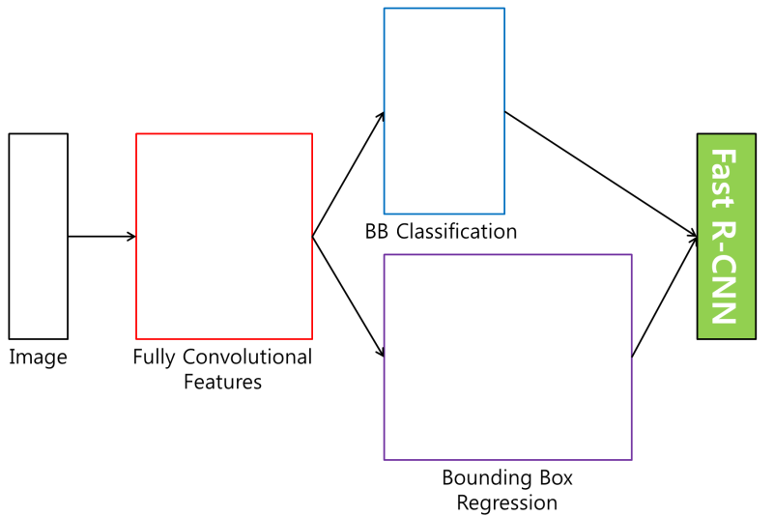
R-CNN vs. SPP net vs. Fast R-CNN
R-CNN
SPP net
Fast R-CNN
Faster R-CNN

Slide 9
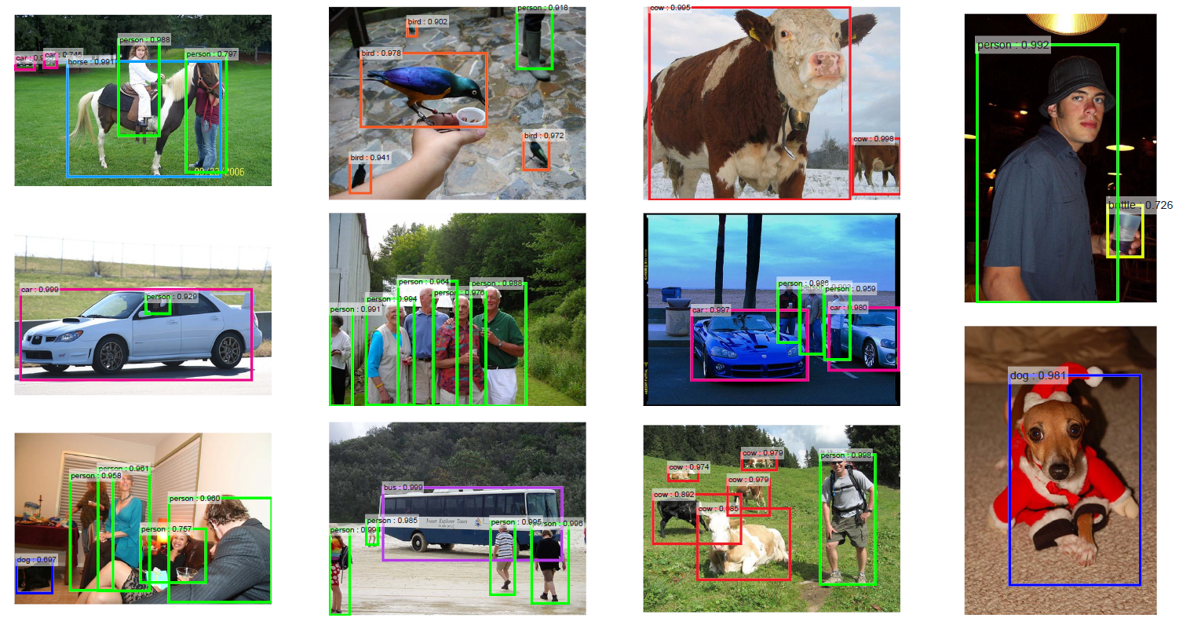
Results

Slide 10
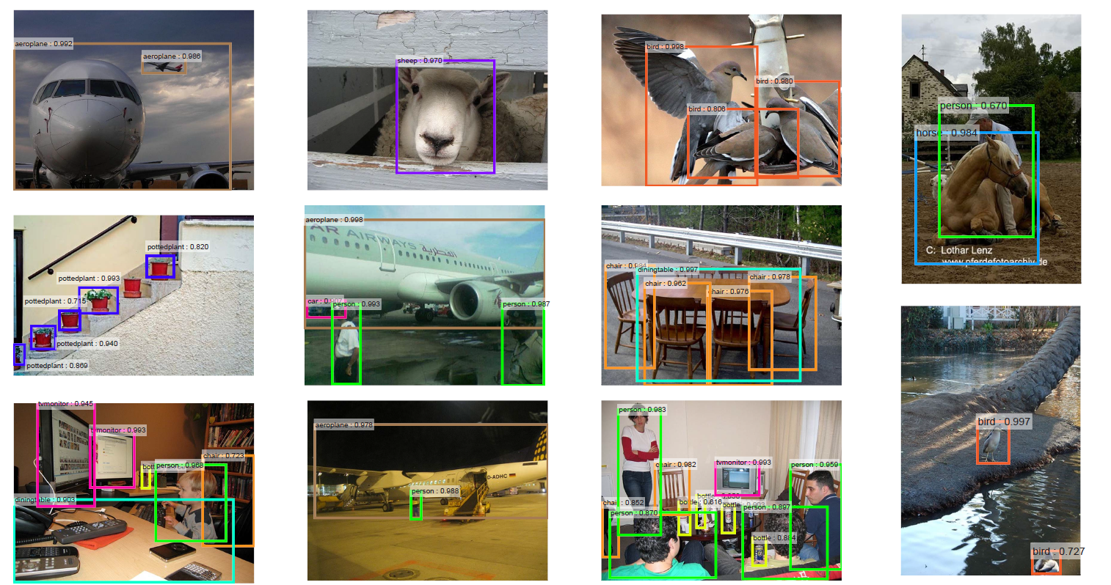

Slide 11
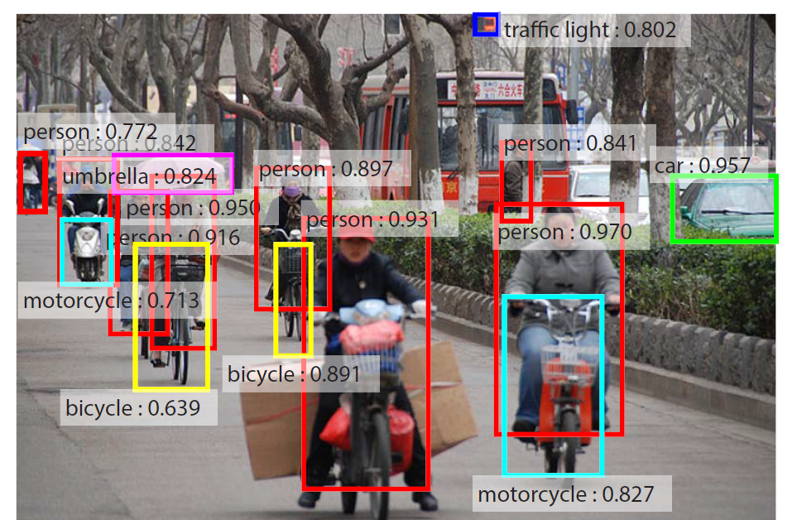

Slide 12
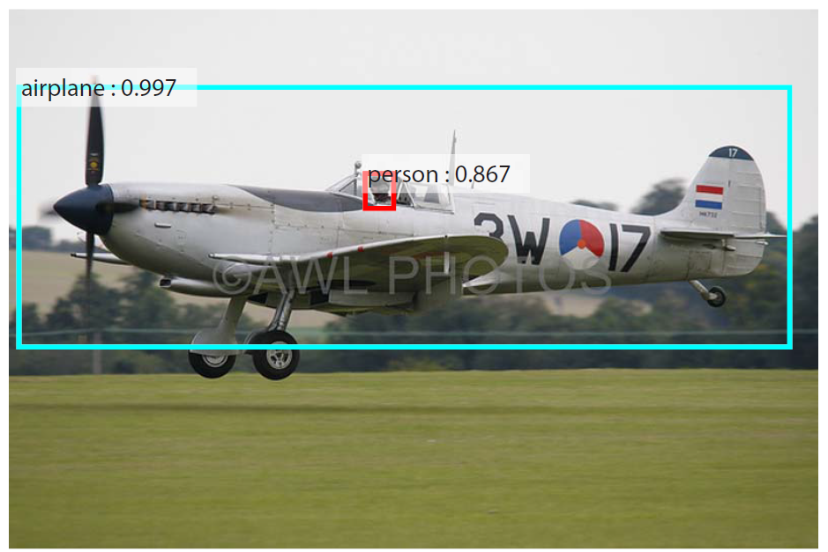

Slide 13
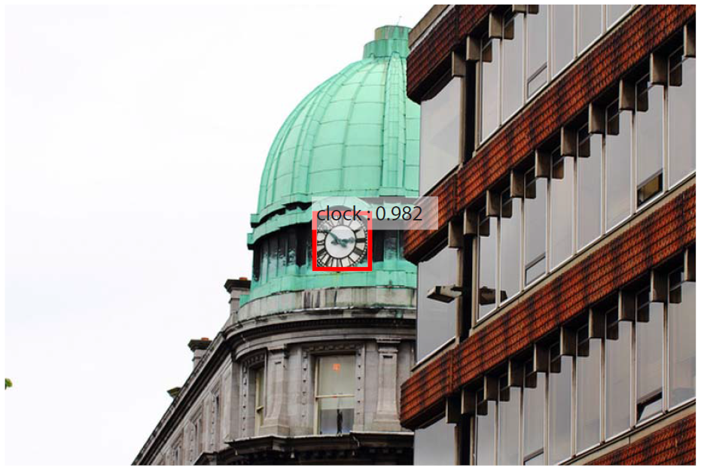

Slide 14
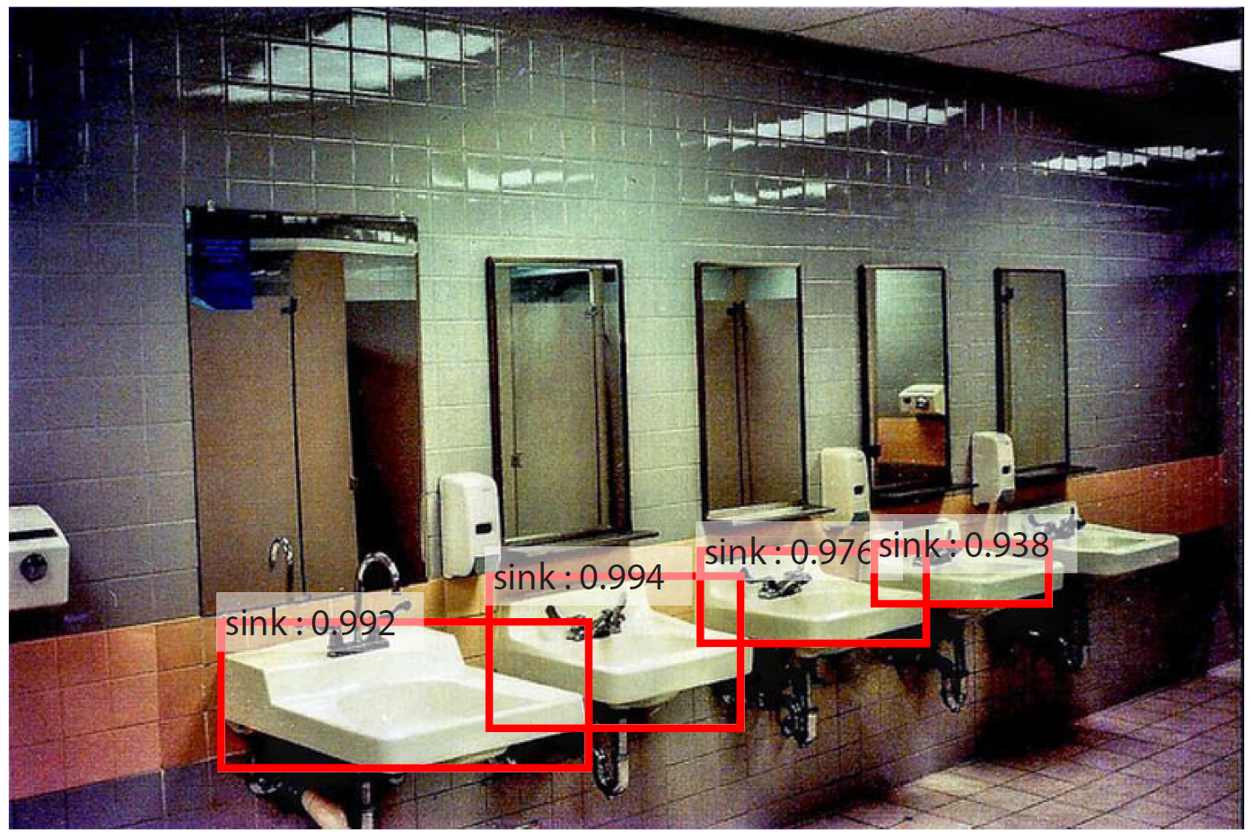

Slide 15

YOLO?

Slide 16

YOLO
You Only Look Once
Quiet similar with Faster R-CNN and very FAST!

Slide 17
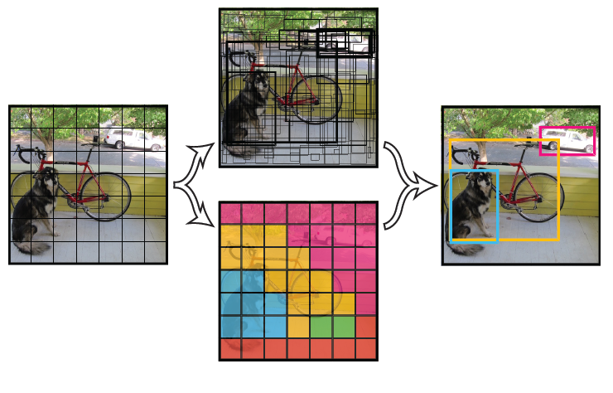
YOLO

Slide 18

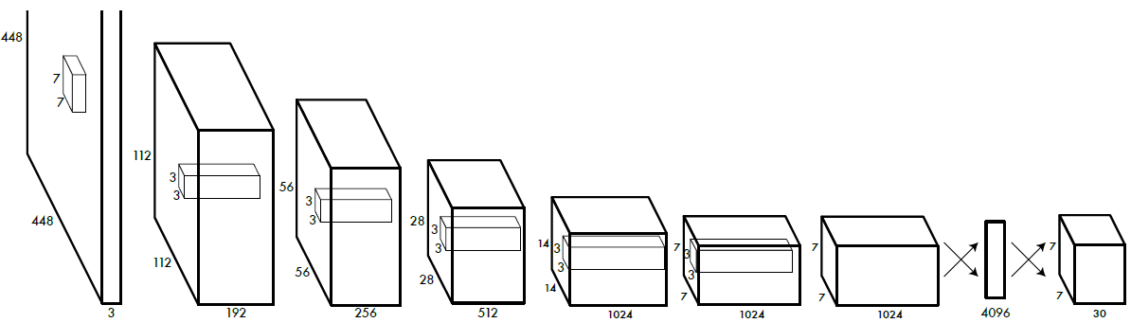
YOLO
Faster R-CNN
30 = 2*5 + 20
Each 49 (=7*7) points produce
- 2 bounding box information (4 boundaries + 1 confidence)
- 20 class prediction information

Slide 19

Pros and Cons
Very Fast
Not the best performance
Single-stage algorithm
Struggles with small objects
Good recall performance
Not that good at localization

